Slide 1
CSE420
Compiler Design
Department of Computer Science and Engineering | BRAC University

Slide 2
Lecture Topic: Parsing Ambiguous Grammars
by
Warida Rashid (WAR)
Lecturer

Slide 3
Introduction
LALR stands for Look-ahead LR
Smaller parsing tables than LR(1)
The number of states in an SLR and and LALR for a grammar G is equal
LALR parsers can recognize more grammars than SLR parsers

Slide 4
LALR Parsing Table
A state of an LALR parser contains LR(1) items
Take the similar looking states, i.e. states that have the same core and merge them into a single state

Slide 5
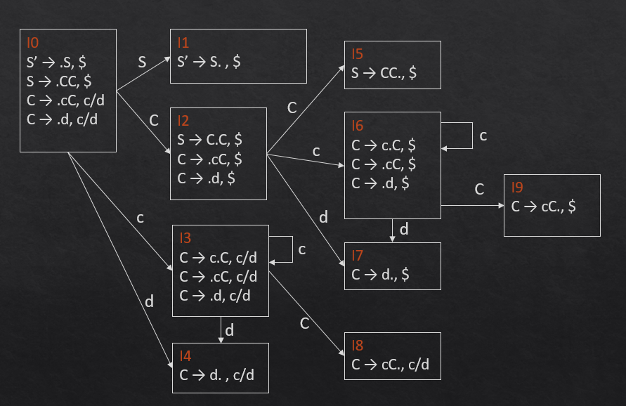
LALR Parsing Table
State I4 and I7 have the same core C → d.
Merge I₄ and I₇ into a single state I₄₇
I₄₇ contains a set of three items represented by [C → d., c/d/$]
I₃ and I₆ have the same core: {C → c.C, C → .cC, C → d}
Merge I₃ and I₆ them into I₃₆ which contains items represented by:
I₈ and I₉ have the same core {C → cC.}
Merge I₈ and I₉ them into I₈₉ which contains items represented by:
GOTO (I, X) are merged. Example: GOTO(I₃₆ , C) = I₈₉
0.S’ → S
1.S → CC
2.C → cC
3.C → d
I₃₆
C → c.C, c/d/$
C → .cC, c/d/$
C → .d, c/d/$
I₈₉
C → cC., c/d/$

Slide 6
Reduce/Reduce Conflict
I₁
A → α., a
B → α., b
I₂
A → α., b
B → α., c
I₁₂
A → α., a/b
B → α., b/c

Slide 7
LALR Parsing Table
States | ACTION |  |  | GOTO
 | c | d | $ | S | C
0 | s3 | s4 |  | 1 | 2
1 |  |  | acc
2 | s6 | s7 |  |  | 5
3 | s3 | s4 |  |  | 8
4 | r3 | r3
5 |  |  | r1
6 | s6 | s7 |  |  | 9
7 |  |  | r3
8 | r2 | r2
9 |  |  | r2
States | ACTION |  |  | GOTO
 | c | d | $ | S | C
0 | s36 | s47 |  | 1 | 2
1 |  |  | acc
2 | s36 | s47 |  |  | 5
36 | s36 | s47 |  |  | 89
47 | r3 | r3 | r3
5 |  |  | r1
89 | r2 | r2 | r2
LR(1) Table
LALR Table

Slide 8
Using Ambiguous Grammars
All grammars used in the construction of LR-parsing tables must be un-ambiguous.
Can we create LR-parsing tables for ambiguous grammars ?
Yes, but they will have conflicts.
We can resolve these conflicts in favor of one of them to disambiguate the grammar.
Why we want to use an ambiguous grammar?
Some of the ambiguous grammars are much natural, and a corresponding unambiguous grammar can be very complex.
Usage of an ambiguous grammar may eliminate unnecessary reductions.

Slide 9
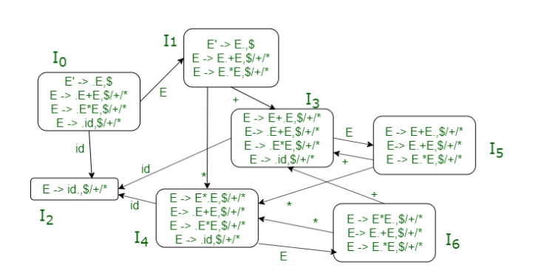
Using Ambiguous Grammars
Example:
E → E+E | E*E | id
Fig. LR (1) automaton for the grammar

Slide 10
Associativity and Precedence
Input: id+id+id$
Stack | Symbol | Input
0 |  | id+id+id$
02 | id | +id+id$
01 | E | +id+id$
013 | E+ | id+id$
0132 | E+id | +id$
0135 | E+E | +id$
01353 | E+E+ | id$
013532 | E+E+id | $
013535 | E+E+E | $
0135 | E+E | $
01 | E | $
0. E’ → E
1. E → E+E
2. E → E*E
3. E → id
E
E
 | Actions |  |  |  | GOTO
 | id | + | * | $ | E
I₀ | S2 |  |  |  | 1
I₁ |  | S3 | S4 | Acc
I₂ |  | r3 | r3 | r3
I₃ | S2 |  |  |  | 5
I₄ | S2 |  |  |  | 6
I₅ |  | R1/S3 | R1/S4 | R1
I₆ |  | R2/S3 | R2/S4 | R2
E
E
E
id
+
id
+
id
If the current token is +:
Shift → + is right associative
If the current token is *:
Shift → * has higher precedence than +

Slide 11
Associativity
Input: id + id + id$
Stack | Symbol | Input
0 |  | id+id+id$
02 | id | +id+id$
01 | E | +id+id$
013 | E+ | id+id$
0132 | E+id | +id$
0135 | E+E | +id$
01 | E | +id$
013 | E+ | id$
0132 | E+id | $
0135 | E+E | $
01 |  | $
0. E’ → E
1. E → E+E
2. E → E*E
3. E → id
E
E
 | Actions |  |  |  | GOTO
 | id | + | * | $ | E
I₀ | S2 |  |  |  | 1
I₁ |  | S3 | S4 | Acc
I₂ |  | r3 | r3 | r3
I₃ | S2 |  |  |  | 5
I₄ | S2 |  |  |  | 6
I₅ |  | R1/S3 | R1/S4 | R1
I₆ |  | R2/S3 | R2/S4 | R2
E
E
E
id
+
id
+
id
If the current token is +:
Reduce→ + is left associative
If the current token is *:
Reduce → + has higher precedence than *

Slide 12
Conflict Resolution
According to the precedence and associativity of our example, the conflict is resolved as follows:
The shift/reduce conflict at I_{5:}
On “+”, keep the reduce move and discard the shift move, which makes “+” left associative.
On “*”, keep the shift move and discard the reduce move, which gives “*” higher precedence over “+”.
The shift/reduce conflict at I_{6:}
On “+”, keep the reduce move and discard the shift move, which gives “*” higher precedence over “+”.
On “*”, keep the reduce move and discard the shift move, which makes “*” left associative.

